Slide 1
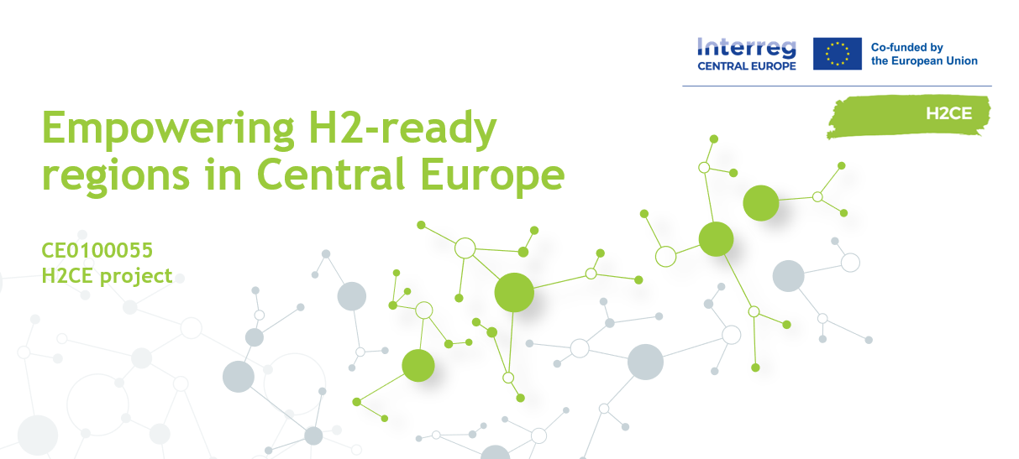
H2CE Final Conference
Berlin, 25 March 2026
Pedro Brosei, Joint Spatial Planning Department Berlin-Brandenburg (Gemeinsame Landesplanungsabteilung), Lead Partner Project Manager

Slide 2

Empowering H2-ready regions in Central Europe
Transitioning to green energy is key to tackling climate change and creating sustainable economies.
Green hydrogen holds significant promise but accounts for less than 2 percent of Europe’s current energy consumption.

Slide 3
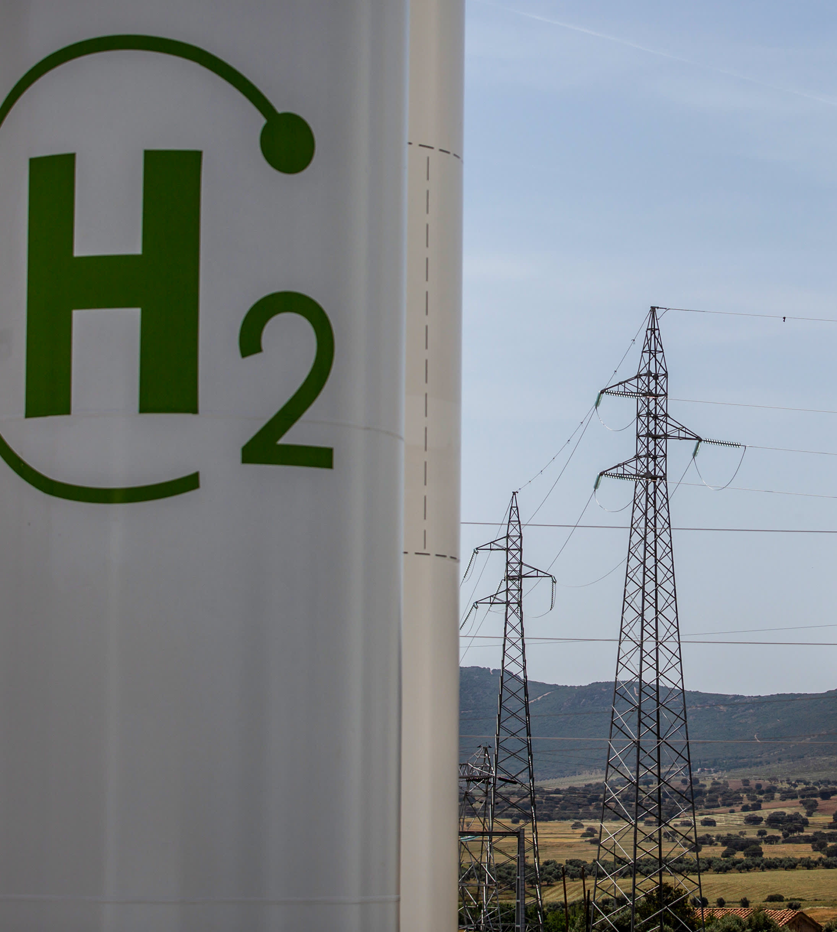
Common challenge
The common challenge H2CE is tackling was a smart integration of hydrogen solutions & renewable energies into the regional energy transition to reduce GHG emissions from different sectors. The project focused on transferable energy planning at local & regional levels for EU regions.

Slide 4

Mission
The H2CE project helped regions in Central Europe to boost the integration of hydrogen in their local and regional energy planning.
The project developed and tested new planning tools for public authorities and created a network of hydrogen-ready regions for good practice exchanges.

Slide 5


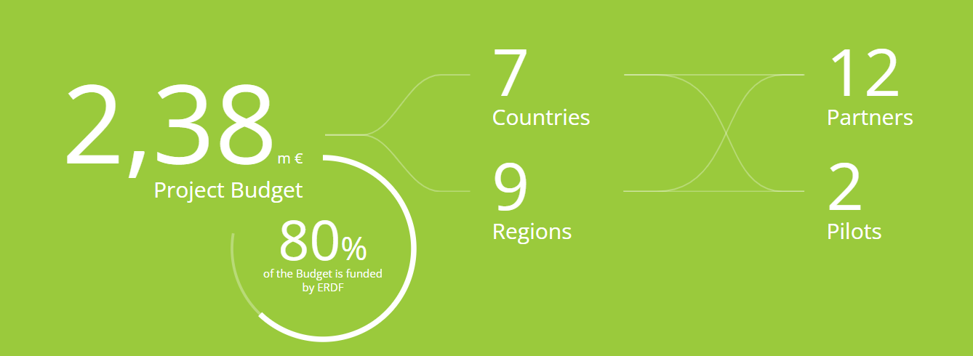
H2CE in numbers
Duration: 04.2023-03.2026

Slide 6
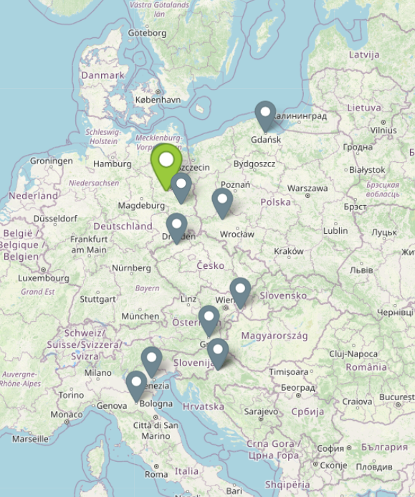







Project Partnership
Joint Spatial Planning Department Berlin-Brandenburg
Regional Development Agency Northwestern-Brandenburg
City and Regional Utilities Lübben
Foundation “Dumni z Lubina”, Lower Silesia
The Pomorskie Voivodeship, Marshal’s Office, Energy Dep.
City of Zagreb
North-West Croatia Regional Energy and Climate Agency
Institute for Transport and Logistics Foundation, Emilia-Roma.
Regional Union of Chambers of Commerce of Veneto Region
Energy Agency of Styria
Economic and Social Council of the Ústí region
Institute for Public Service Development

Slide 7
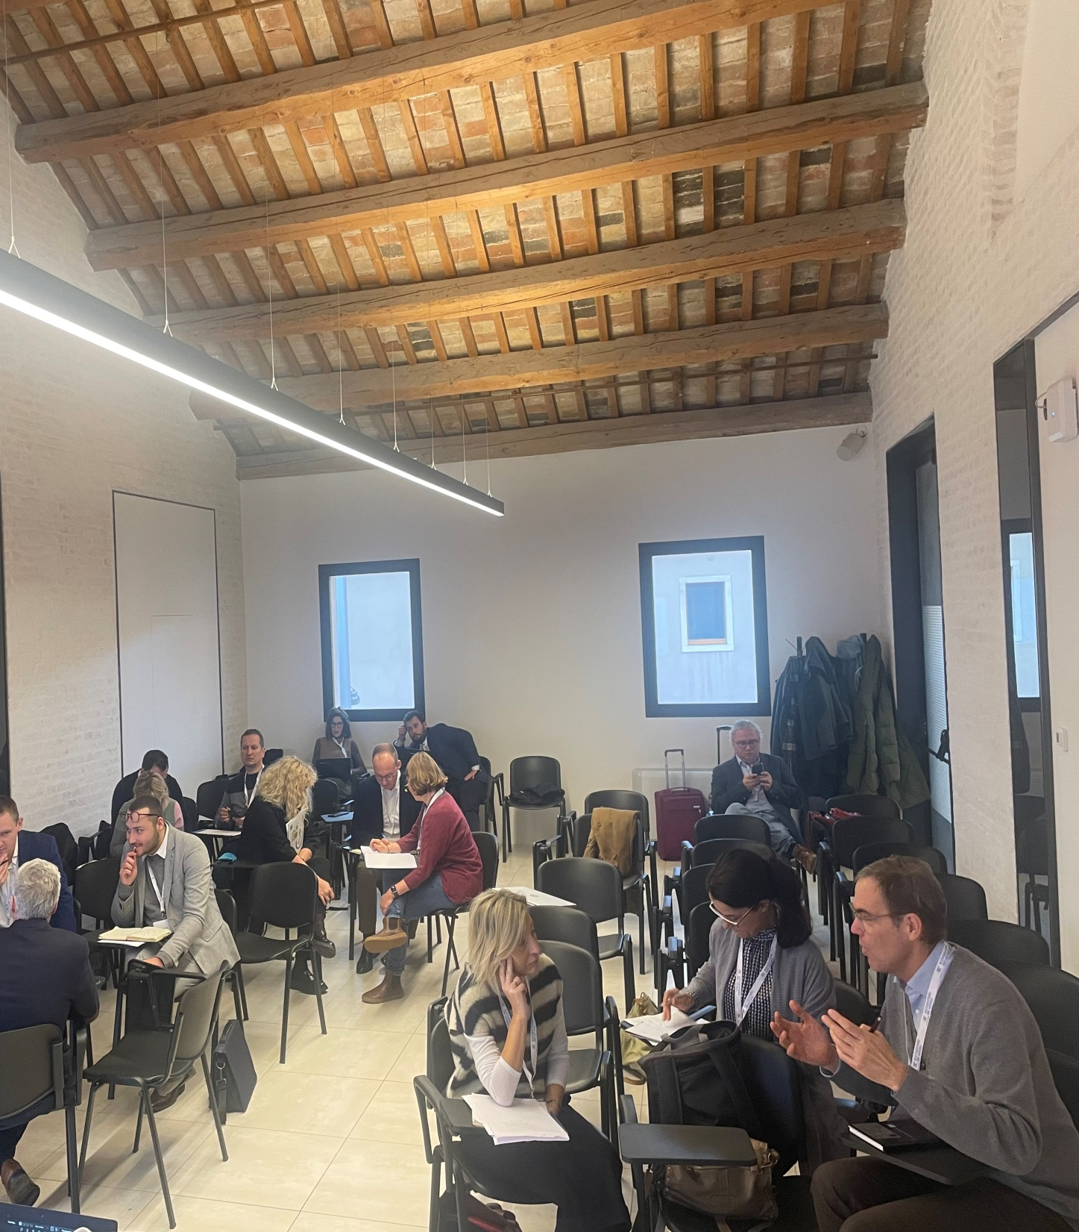
H2CE activities and outputs
H2-ready for European and regional spatial planning and development
Activities: Planning the transition, challenges and solutions through common indicators and regional analysis; Guidelines for Strategies and Action Plans, Development of Strategies on different levels and regional action plans
Outputs: Transnational, interregional and regional strategies, Regional Action Plans
H2-ready regions: Support mechanisms for energy system transition and participation
Activities: Development and testing of Support Mechanisms for a development of cost-efficient hydrogen infrastructure, Handbook, Peer Reviewing
Developing Central Europe Hydrogen network and Collaboration Platform
Outputs: Transnational H2CE Network (28 Organisations cooperating across borders); H2CE Solutions: Handbook for strategic-decision making; Regional Competence Centres – both integrated in the Collaboration Platform
Outputs: Tool for strategic decision support and planning and Testing of regional Competence Centres
Activities: Developing a transnational H2CE Network; Uptake of H2CE Solutions and Collaboration Platform

Slide 8


WP1: H2-ready for European and regional spatial planning and development Main goal: Analysis and identification of common challenges & solutions in planning and governance processes for “H2-readiness” from a regional, transregional & transnational perspective to develop joint strategies and action plans.

Slide 9
WP1 – Overview
A.1.1: Planning the transition in European regions: challenges and solutions in H2-ready regions
A.1.2: Strategy and action plan development
3 Strategies
Transnational (PP1 + AO13)
Interregional (PP10, PP12)
Regional (PP9)
D.1.1.1: Fact sheet common indicators - PP 1
D.1.2.1: Guidelines - PP 1
Strategy Guideline
Action Plan Guideline
Regional analyses
PP 1,2,3,4,5,6,7,8,9,10,12
D.1.2.2: Strategies
2 Action Plans
Action Plan PP2
Action Plan PP8
D.1.1.2: Summary of transferable regional results - PP 1
D.1.2.3: Action Plans

Slide 10
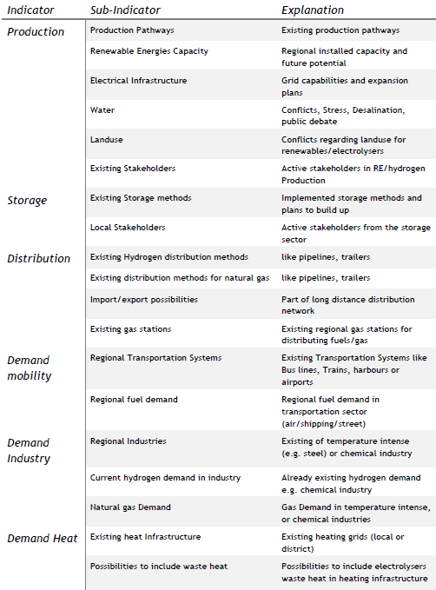
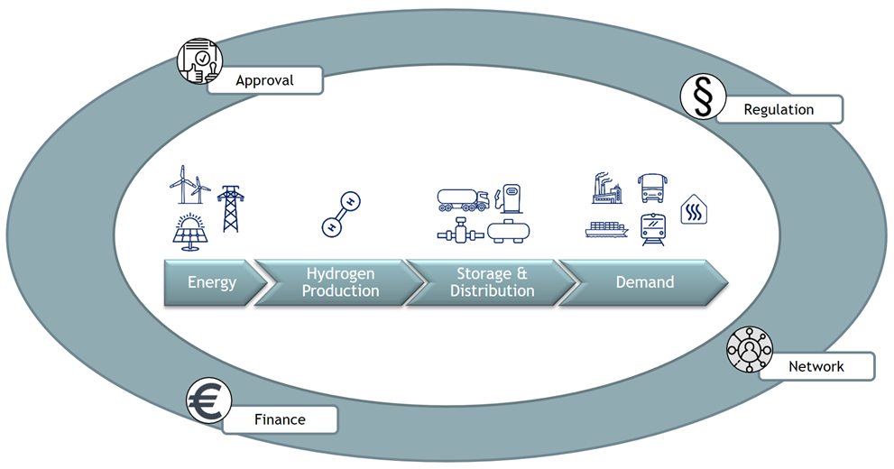
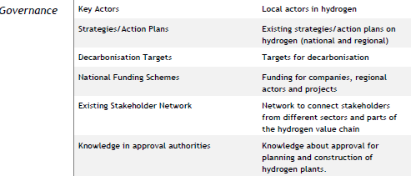

WP1: Development of common indicators for „H2-readiness“ in planning and development processes

Slide 11
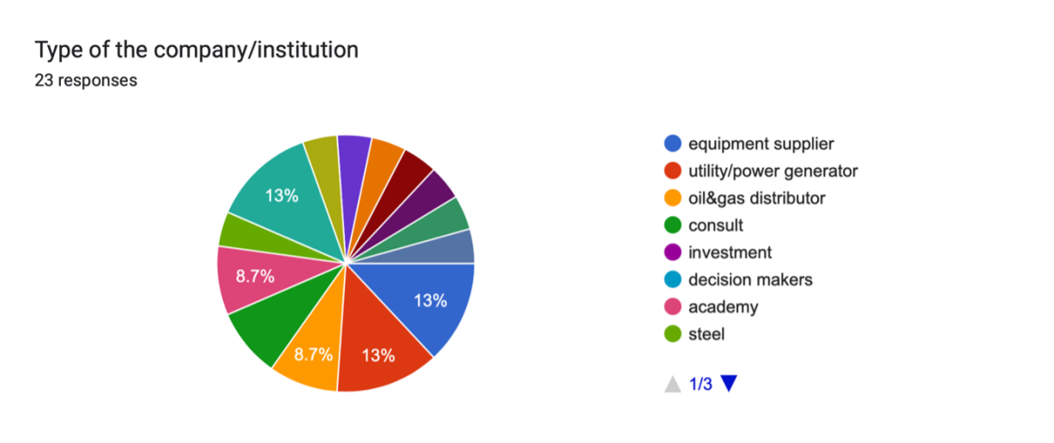
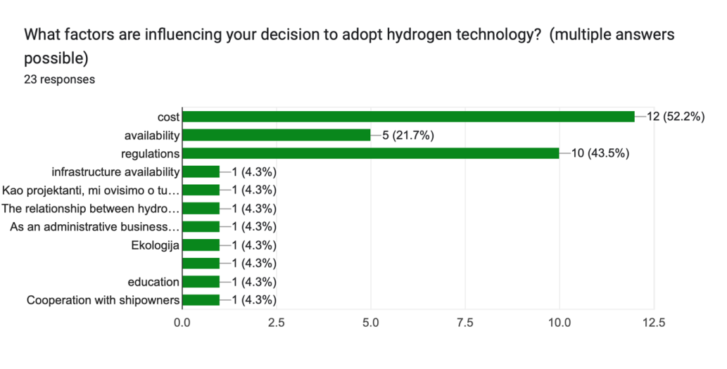
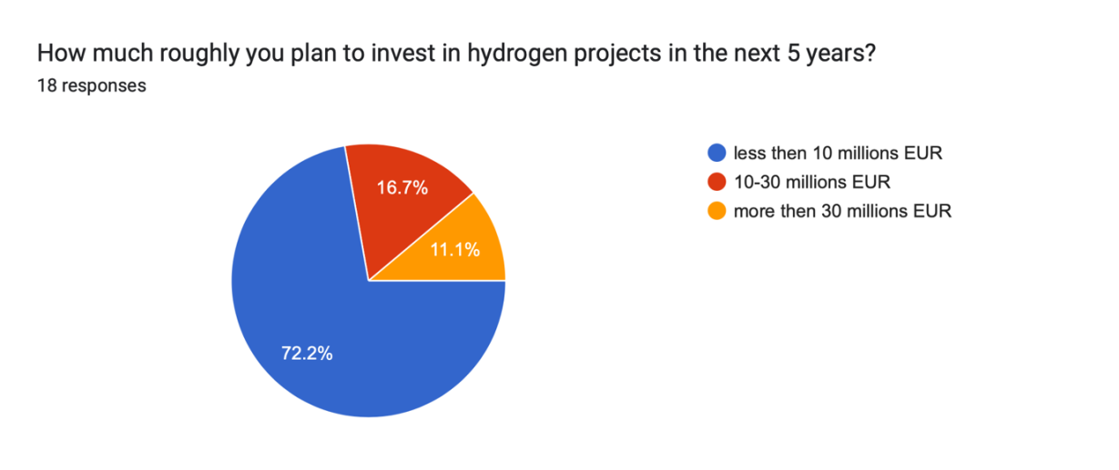
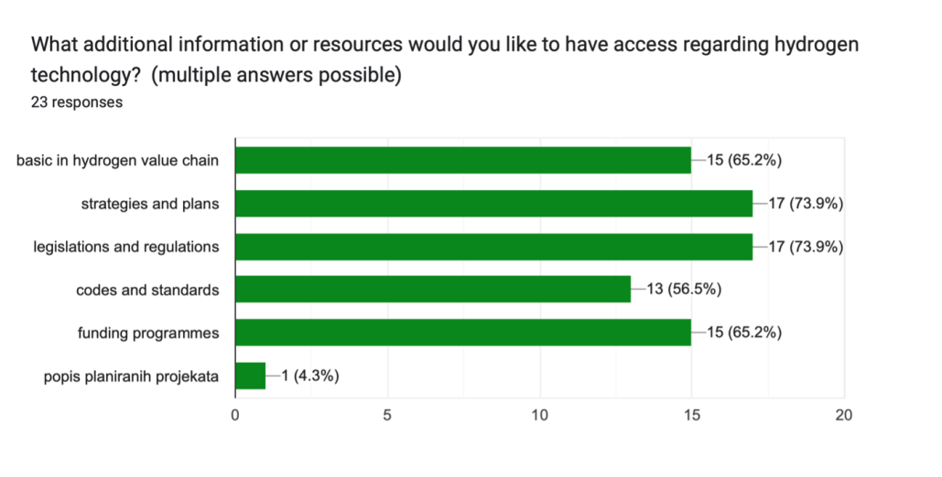
WP1: Mapping Hydrogen Potential on a regional level
Example for results of the analysis: City of Zagreb, Zagreb County, and Krapina-Zagorje County
Notes:
The chart reveals that cost is the predominant factor influencing the adoption of hydrogen technology, followed by regulatory issues and availability. These top three factors highlight the practical and logistical concerns businesses face when considering new technology.
While other factors like infrastructure availability, dependencies on other factors, ecology, education, and specific industry cooperation are mentioned, they play a much smaller role. This suggests that addressing cost and regulatory challenges, along with ensuring the availability of hydrogen, could significantly boost the adoption of hydrogen technology.

Slide 12
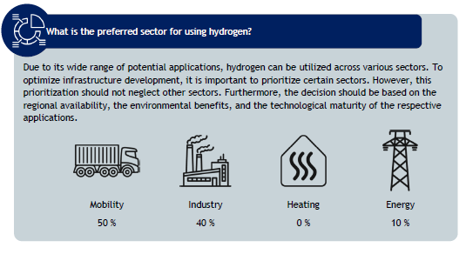

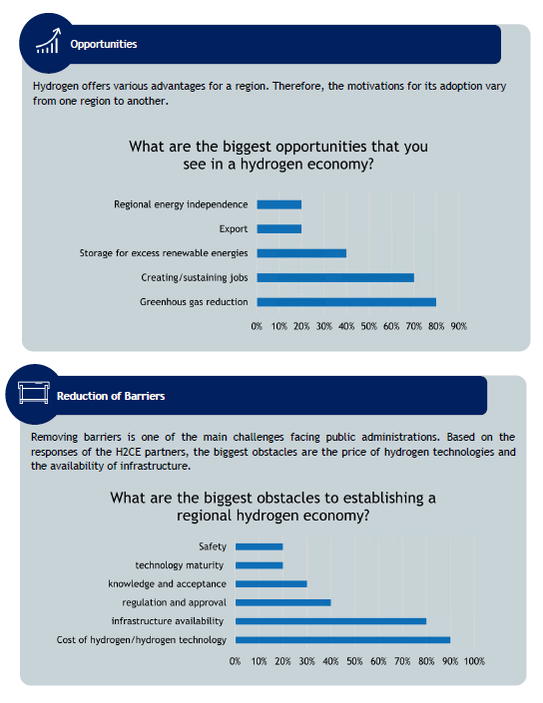
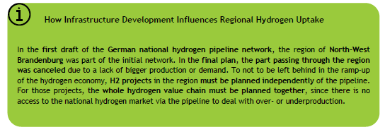
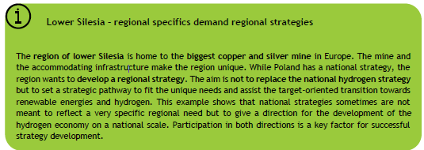
WP1: Summary of the regional analysis

Slide 13
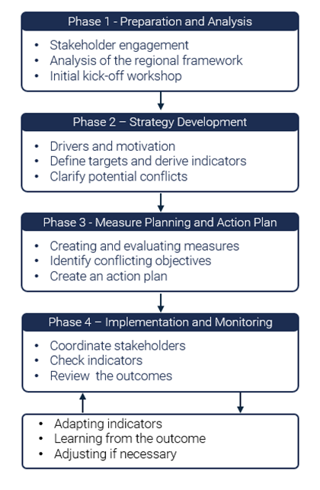
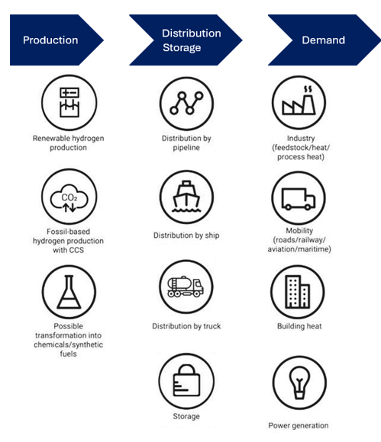
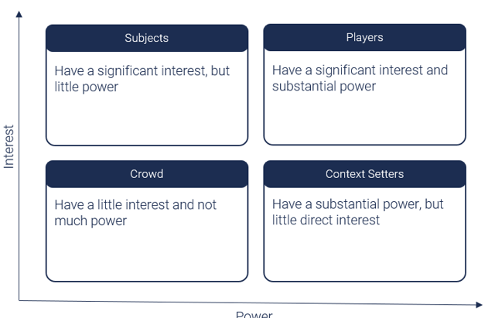
WP1: Developing Guidelines for Strategies & Action Plans

Slide 14
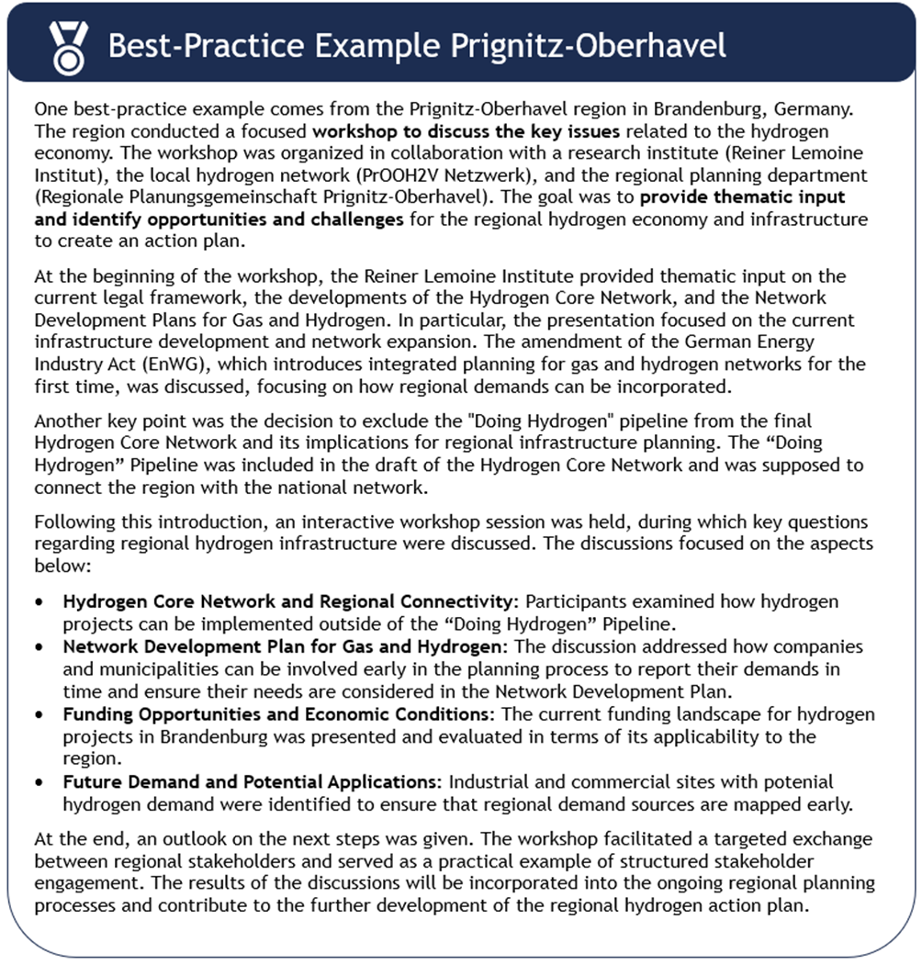
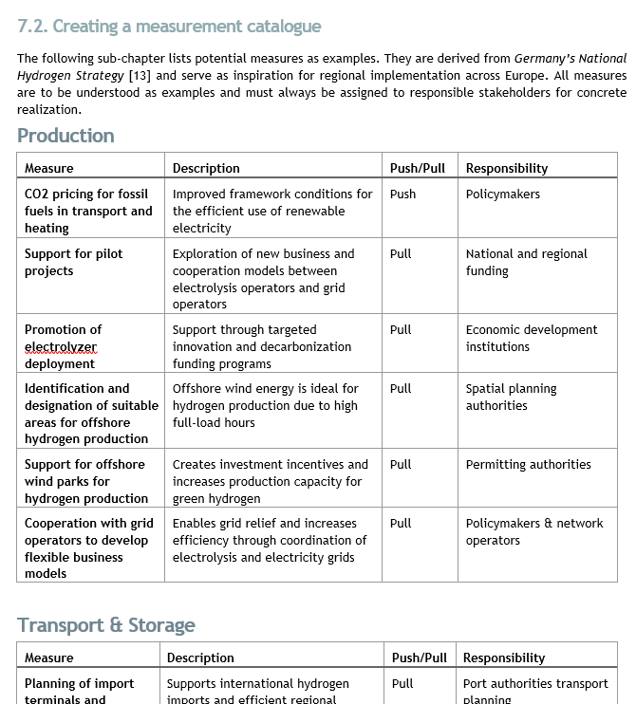
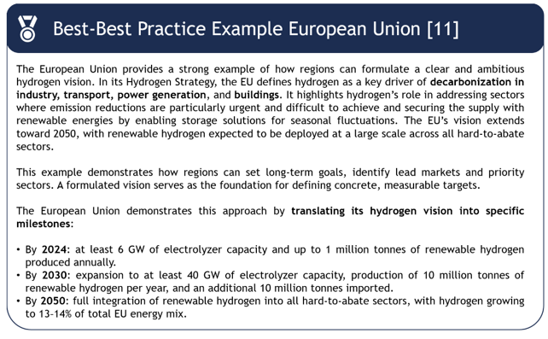
WP1: Developing Guidelines for Strategies & Action Plans

Slide 15
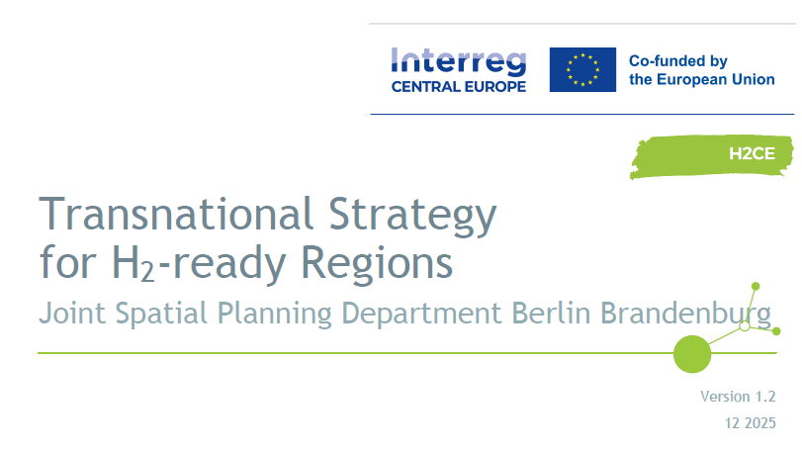
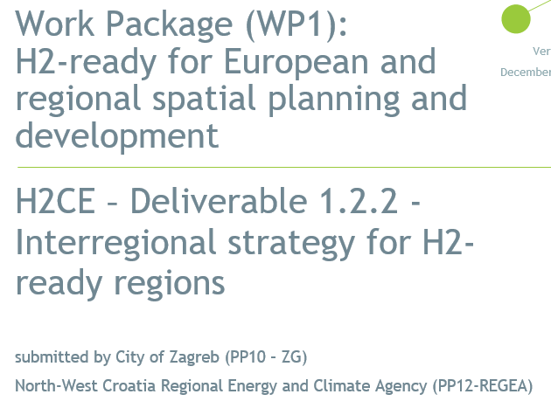
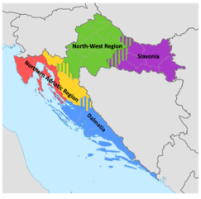
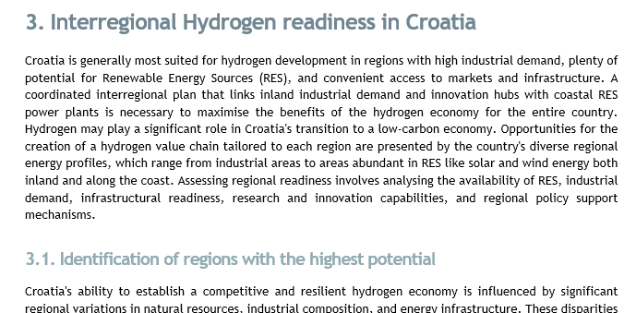
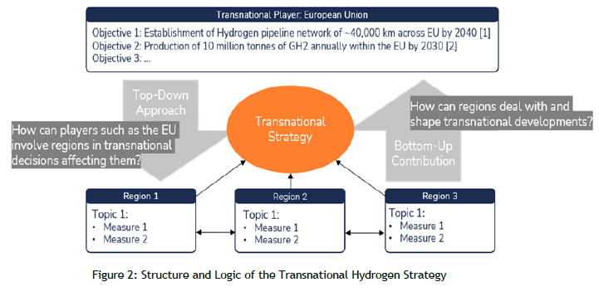
WP1: Development of Strategies: Transnational, interregional, regional

Slide 16

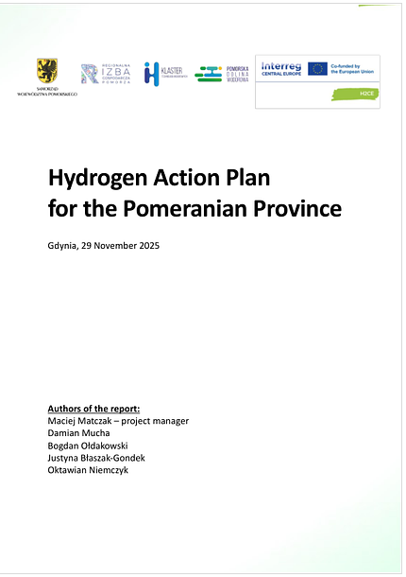
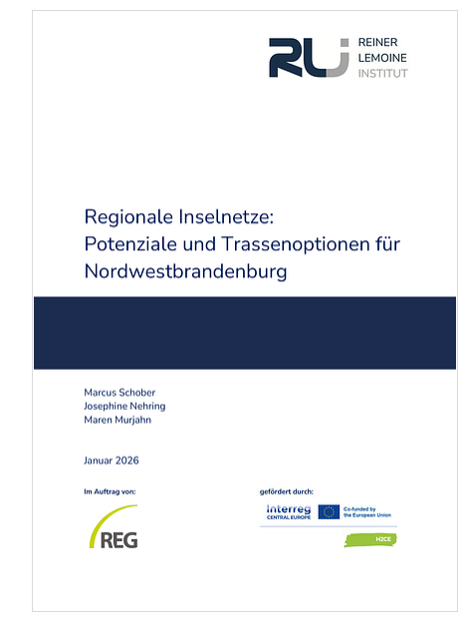
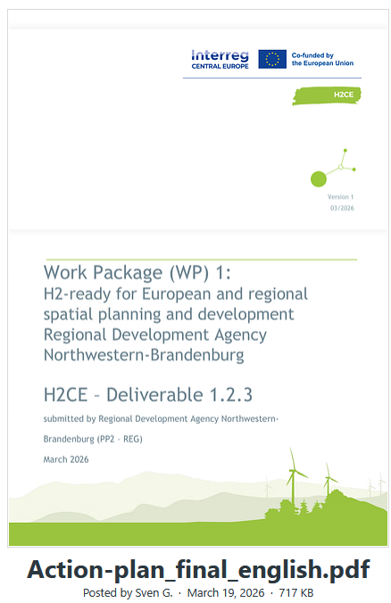
WP1: Regional Action Plans

Slide 17

WP2: H2-ready regions: Support mechanisms for energy system transition and participation

Slide 18
WP2 H2-ready regions: Support mechanisms for energy system transition and participation Overview
The main goal is to develop an energy system model to identify a cost-efficient hydrogen infrastructure set-up and link it to a GIS-based tool aligning cross-regional hydrogen transition projects and activities to identify gaps and avoid overcapacities.
Additionally, we will identify a common framework for setting up regional H2 competence centres for capacity building of regional and local public and private stakeholders to accompany the hydrogen-based energy transition in each region.
Developed H2 vouchers will represent a possible “ready-to-use” option for financial support of projects related to the hydrogen economy / hydrogen value chain.

Slide 19


WP2: Support mechanisms
A.T2.1 Support mechanisms I: mapping and modelling regional H2 energy systems
A.T2.2. Support mechanisms I: regional capacity building
2.1.1 Digital GIS database: methodology, prototype and evaluation results
2.1.2 Energy cells model: results of modelling and evaluation
2.1.3 Report on the testing of a strategic decision-support tool
2.2.1 Report on the testing of training course capacity building at public & private organisations
2.2.2 H2 voucher mechanism for hydrogen utilisation in Usti
2.2.3 Report on the testing of regional H2 Competence Centres
2.2.4 Peer review document of pilots’ results and mainstreaming at the EU and national levels

Slide 20
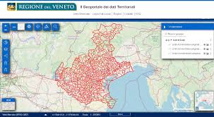
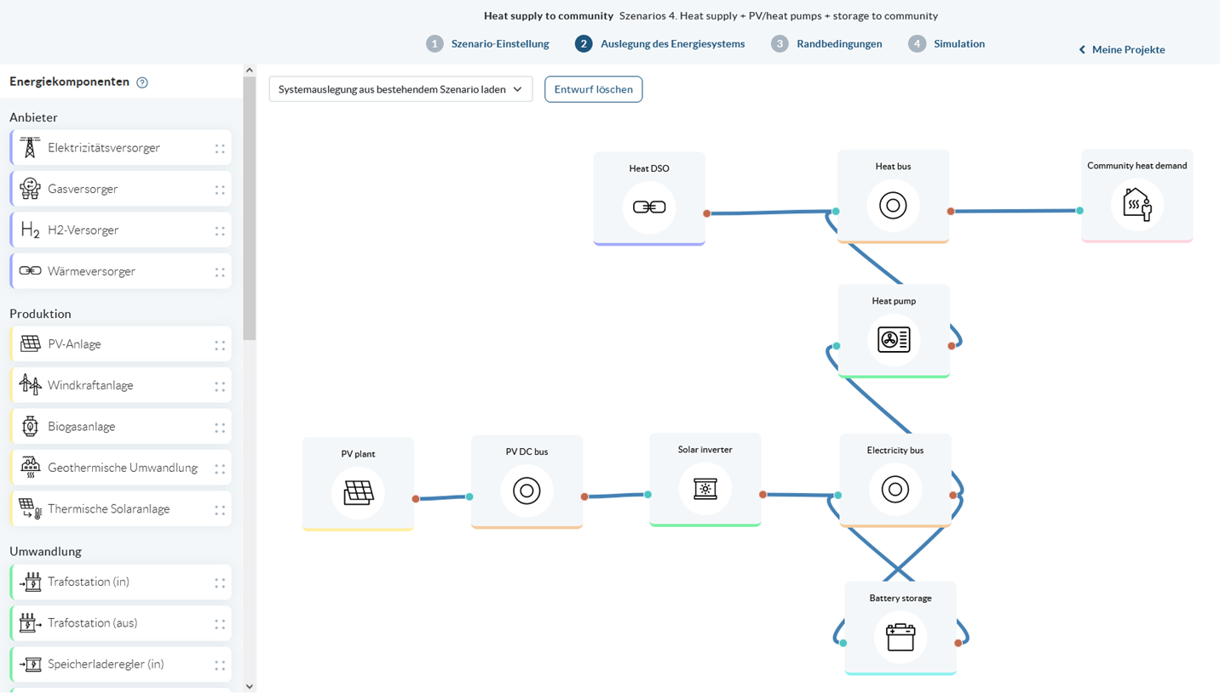

WP2: Strategic decision support tool: Regional GIS databases/Tools & Energy Cell Modelling
Main Goal: To support public decision makers in making choices to plan and monitor investments in the field of production, distribution, and consumption of hydrogen as an energy source
Veneto (IT) and Styria (AT) GIS tools
Lübben (DE) Energy Cell Model

Slide 21

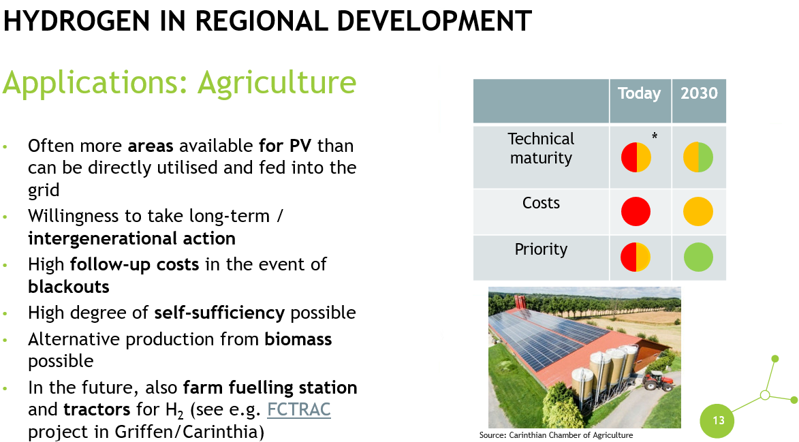
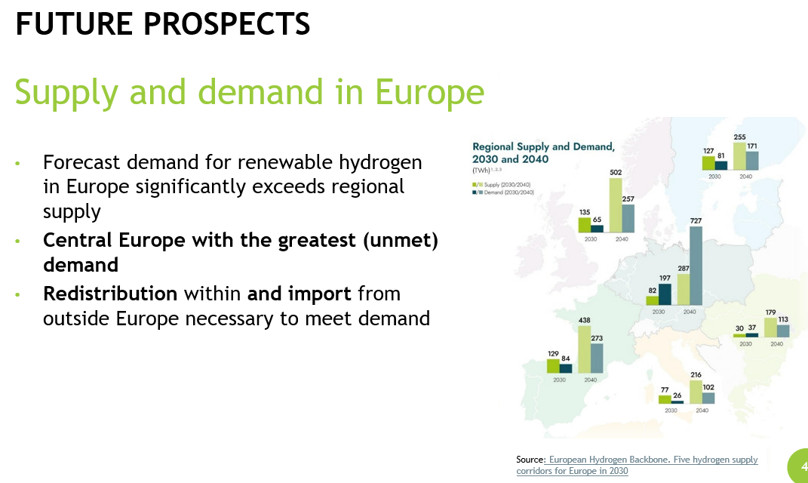
WP2: Regional Capacity building
Training material from Styria, Austria:

Slide 22
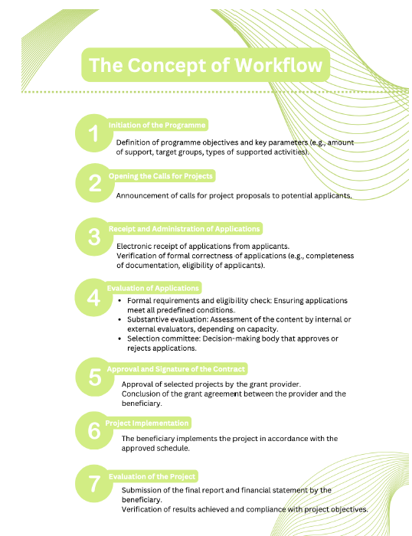
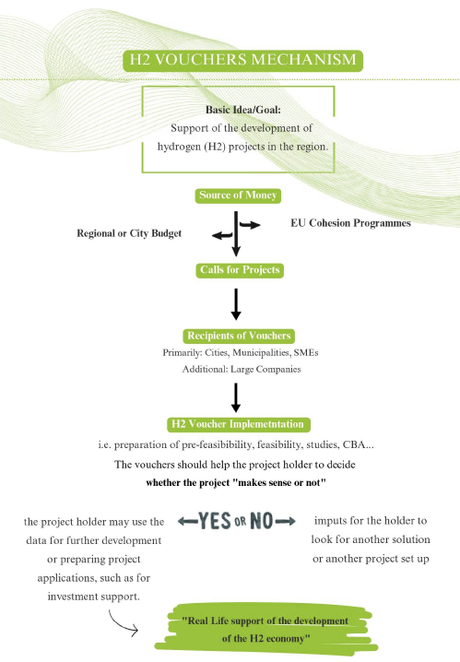
WP2: Incentives for regional capacity building
H2 voucher mechanism developed in Ustí Region, CZ:

Slide 23
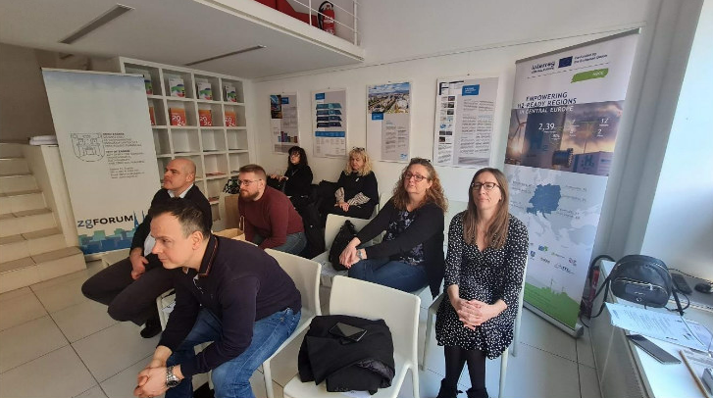
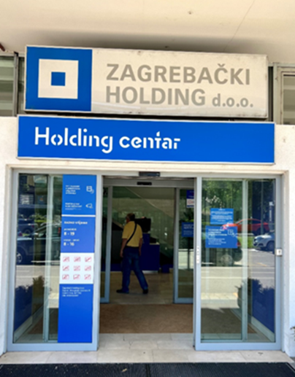
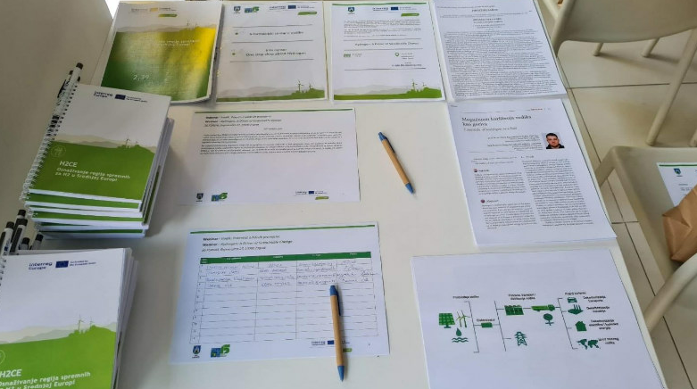
WP2: Regional Capacity building
Zagreb (HR) H2- Competence Center „One-stop-shop“

Slide 24
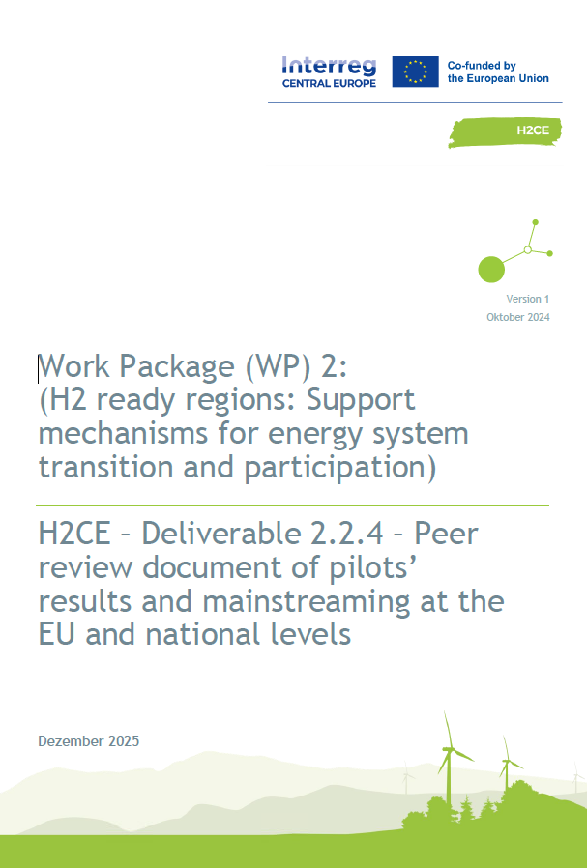
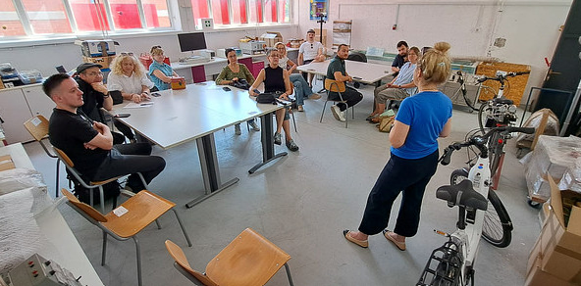
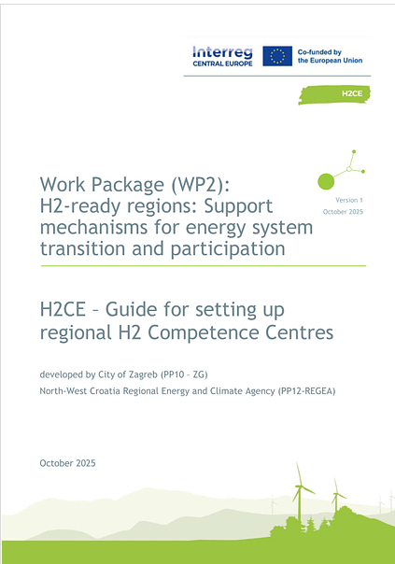

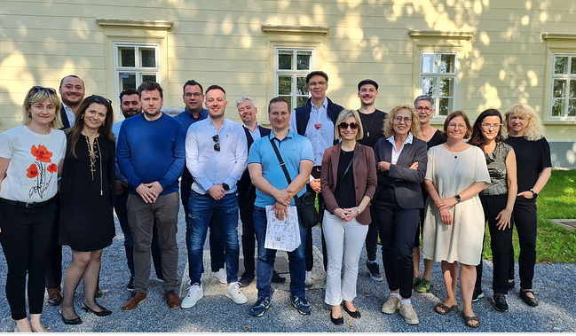
WP2: Joint Competence Center approach as Pilot Action

Slide 25

WP3: Developing Central Europe Hydrogen network and collaboration Platform

Slide 26

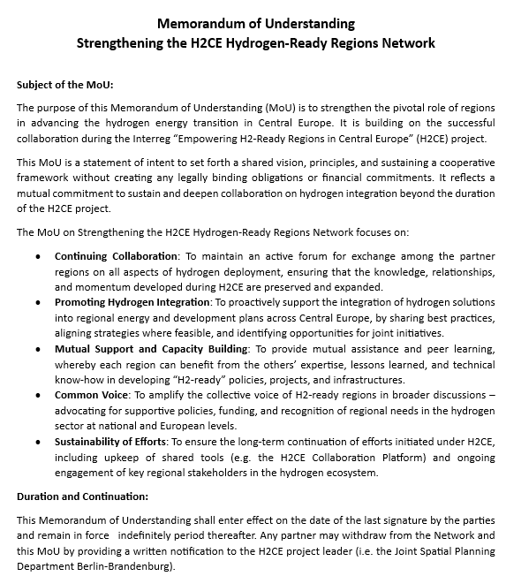
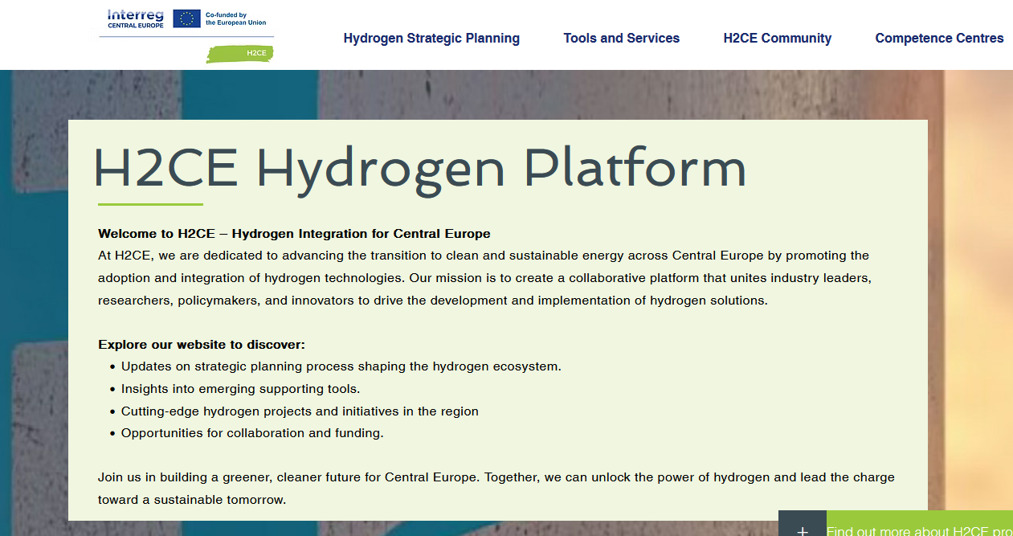
WP3 Developing Central Europe Hydrogen network and Collaboration Platform
Main Goal: to establish a network of key public and private stakeholders at local, regional and transregional levels in Central European to establish H2-ready regions, including an online interactive Collaboration Platform.

Slide 27
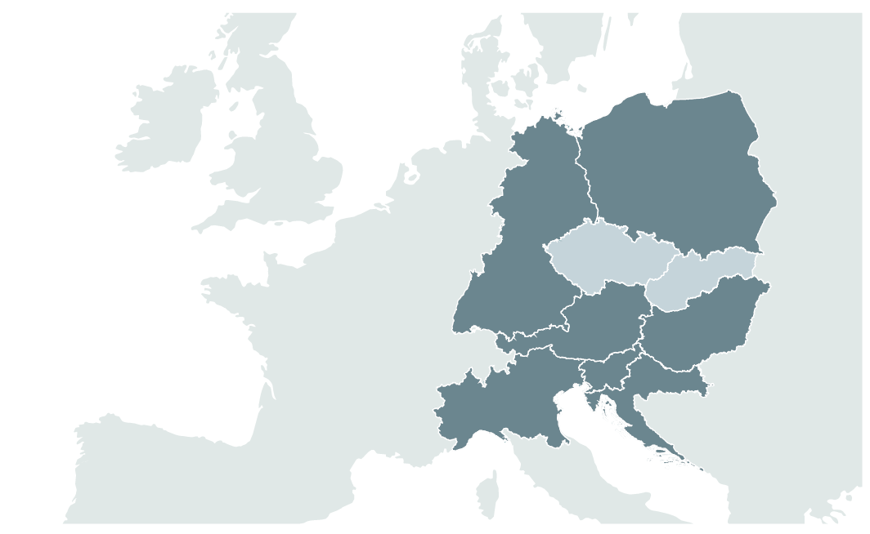
THANK
YOU
Pedro Brosei
Project Manager (Lead Partner)
Email: pedro.brosei@gl.berlin-brandenburg.de
Phone: +49 331 8668725
THANK YOU

